Slide 1
"Unit 4: "For Live Session"
Chad Madding

Slide 2
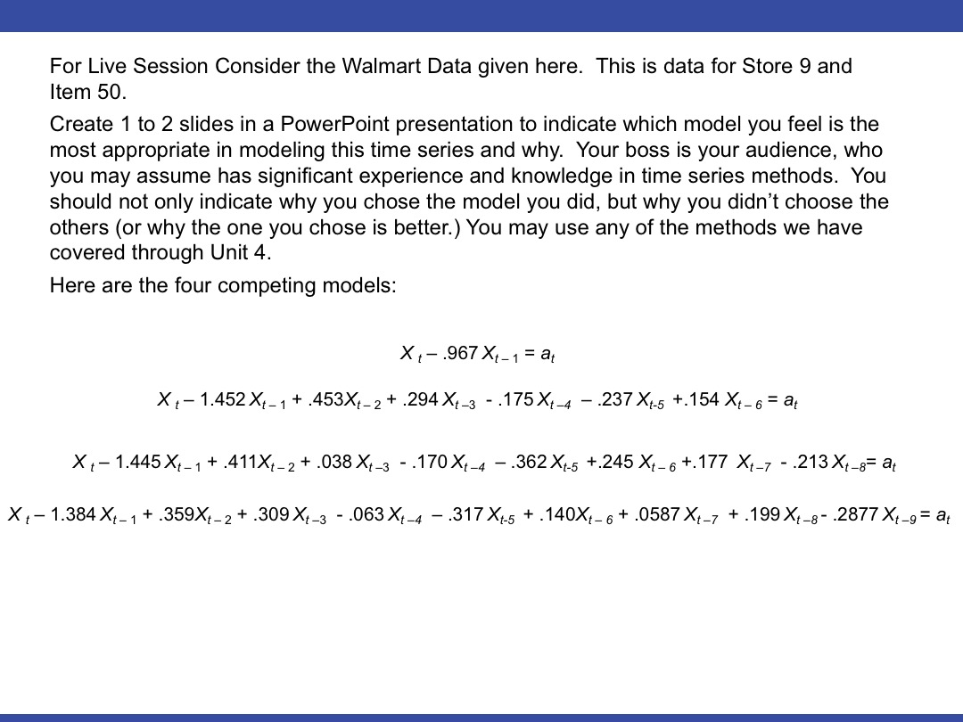
Walmart Data Store 9 Item 50
I feel the most appropriate model would be the AR(9). The AR(8) model was not stationary and the first 2 did not produce results close to the output needed for the Wal-Mart data. The breakdown of the AR(9) model is on the next slide.

Slide 3
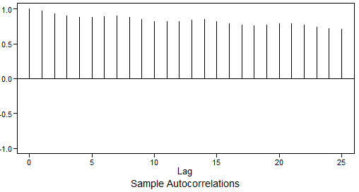
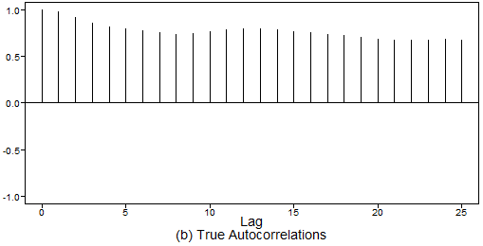
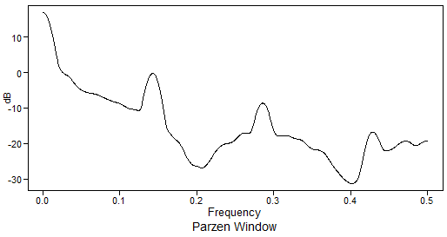
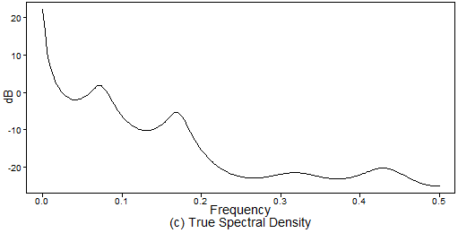
Comparing the autocorrelations and the spectral density of the original data and the model we can see the DNA of the original in the modeled data. The AC show a very slight dampening in both. The spectral density is a bit off but we can see peaks in the original data at 0, a small bump around .03, around .15, close to .29 and one final one around .43. Looking at the System Frequencies of the model shows peeks at 0.0737, 0.1705, 0.3186 and 0.4318.
# X_t -1.384X_t-1 +.359X_t-2 +.309X_t-3 -.063X_t-4 -.317X_t-5 +.140X_t-6 +.0587X_t-7 +.199X_t-8 -.2877X_t-9 = a_t
#Factor Table
factor.wge(phi = c(1.384, -.359, -.309, .063, .317, -.140, -.0587, -.199, .2877))
#Plotting a realization along with true
# autocorrelations and spectral density
plotts.true.wge(phi = c(1.384, -.359, -.309, .063, .317, -.140, -.0587, -.199, .2877))
Original Wal-Mart Data
Modeled Data
System Freq
0.0737
0.1705
0.3186
0.4318

Slide 4


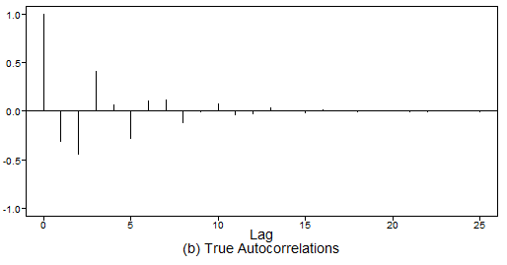
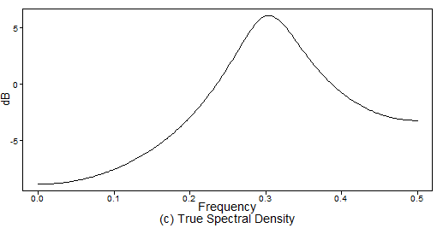
Work out the characteristic equation of the above model.
In addition, find the roots of this characteristic equation and make a judgment of the stationarity of the model.
Next, find the true system frequency of this model using the formula from these slides.
Finally, copy to your slide the true ACF and spectral density of this model.
The Characteristic Equation
1 + .5z + .6z² = 0
The absolute value of the reciprocal (.7746) implies stationarity.
Roots:
-0.4167+-1.2219i
The complex conjugate roots will be associated with:
Pseudo cyclic behavior in the realizations with frequency about f0 = .3023 (cycle length (1/.3023 = 3.3)
Damped sinusoidal autocorrelations with a period (cycle length) of about 3.3
A peak at about .3023 in the spectral density
library(tswge)
# X_t + .5X_t-1 + .6X_t-2 = a_t
#Factor Table
factor.wge(phi = c(-.5, -.6))
#Plotting a relization along with true
# autocorrelations and spectral density
plotts.true.wge(phi = c(-.5, -.6))
Coefficients of Original polynomial:
-0.5000 -0.6000
Factor Roots Abs Recip System Freq
1+0.5000B+0.6000B^2 -0.4167+-1.2219i 0.7746 0.3023

Slide 5
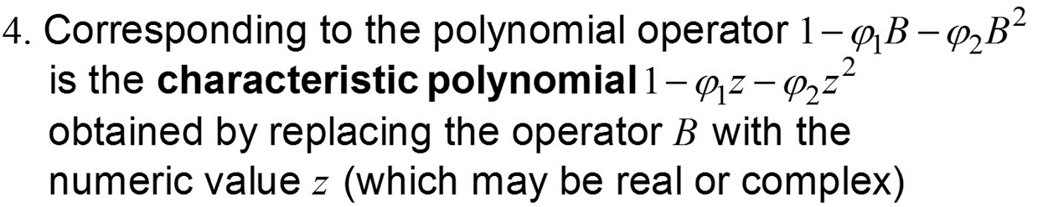




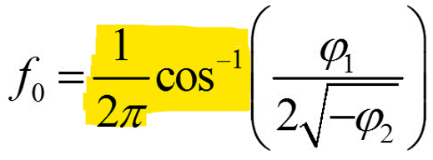
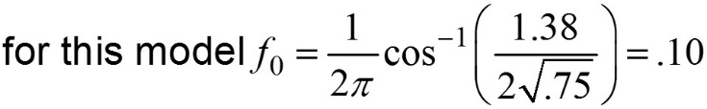
A brief reflection of thoughts and key takeaways – Week 4
This week continued on with a breakdown of the AR(2) and AR(p) models.
Key results
An AR(2) and AR(p) model is stationary if and only if the roots of the characteristic equation are greater than 1 in absolute value (lie outside the unit circle).
Quadratic Formula Example:
Since | r | > 1 the model is stationary
Summarizing: A stationary AR(2) model, (1 − ϕ₁Β − ϕ₁Β ²)X_{t} = a_{t}, whose characteristic equation has complex conjugate roots
Has realizations that show a pseudo-cyclic behavior with cycle length about 1/f₀, where f₀ is given on previous slides
The autocorrelation function has the appearance of a damped sinusoidal with frequency f₀ (i.e., cycle length 1/f₀ )
The spectral density has a peak at about f₀
Question: Either I missed the math for the first part of this sinusoidal function or I just don’t know enough about Trig.
Would you please breakdown the math behind this function?
I am good with phi 1 and 2 and I know how to read the System Frequency output.
I even know the r code to produce the answer: (1/(2*phi1))*acos(phi1/(2*sqrt(phi2)))
Maybe this is all I need but I was just woundering about the math in the formula.
(1/(2*phi1))*acos(1.38/(2*sqrt(.75)))
[1] 0.1032771

